Slide 1
Why Statistics is the Foundation of Data Science
Dr. Tirthajyoti Sarkar
August 31st, 2019

Slide 2
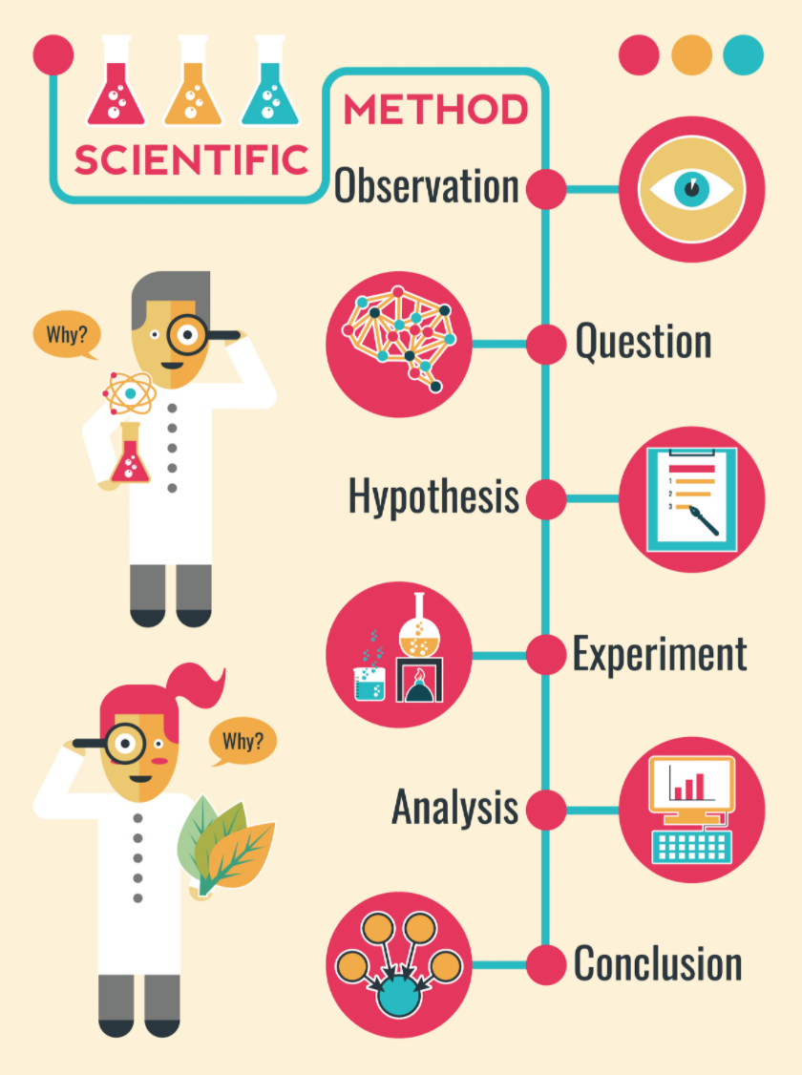
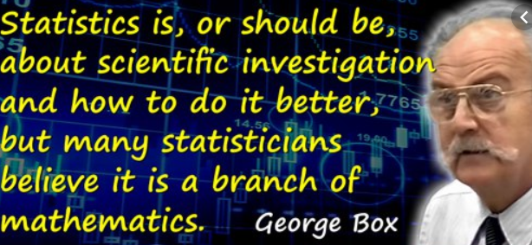
Statistics and the ‘Scientific Method’

Slide 3
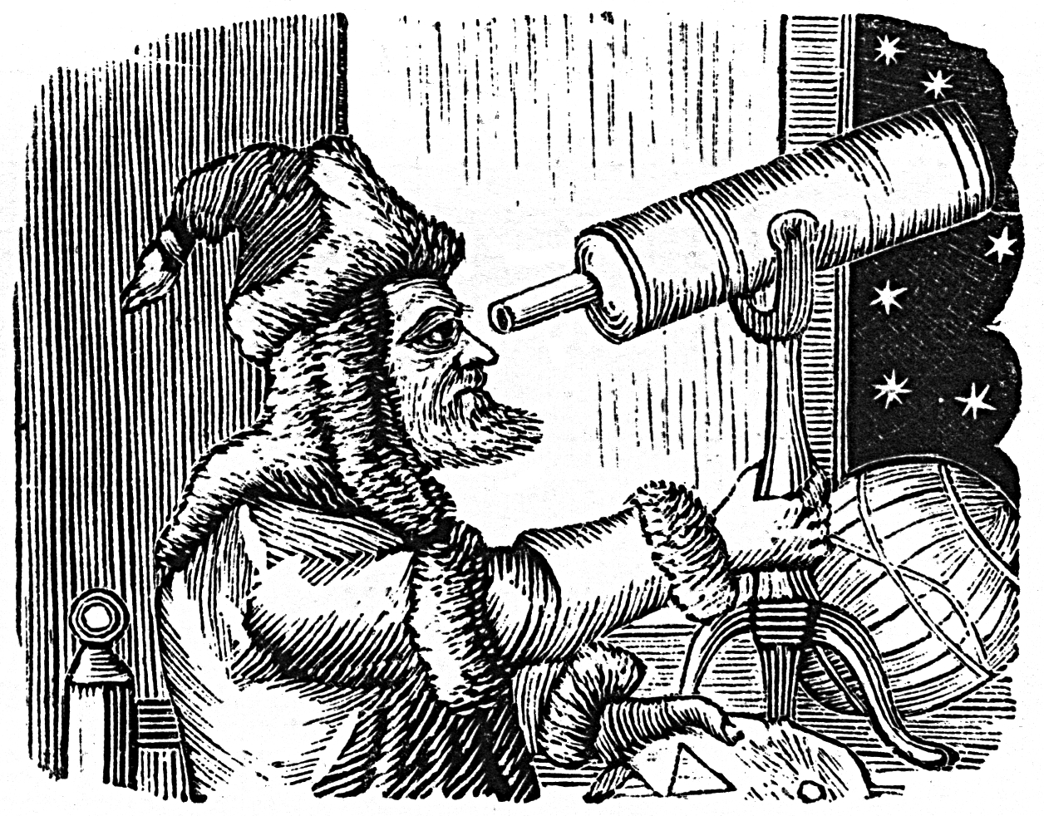
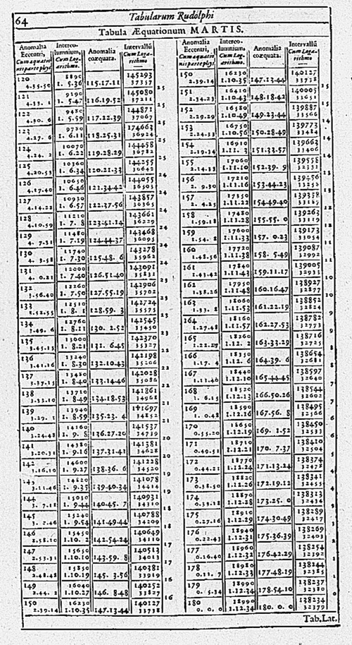
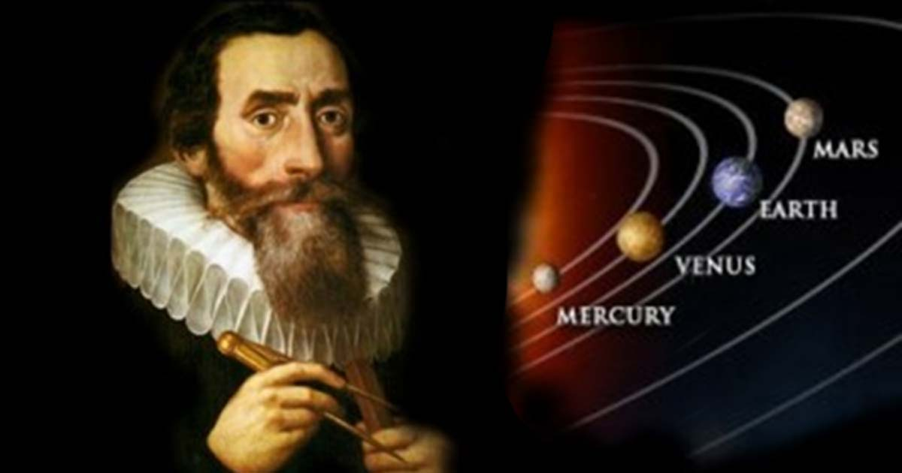
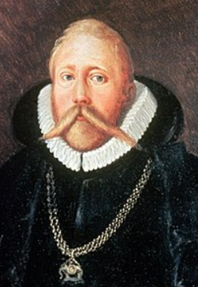
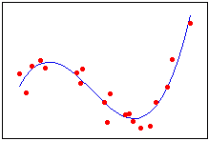
Example of Data Science in 17th century...
The modern science was kickstarted - using data table, and curve fitting...

Slide 4
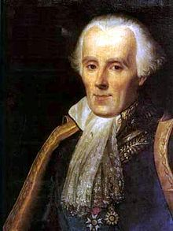
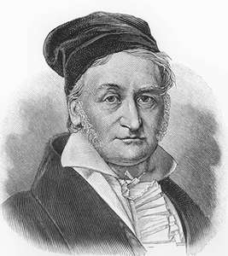
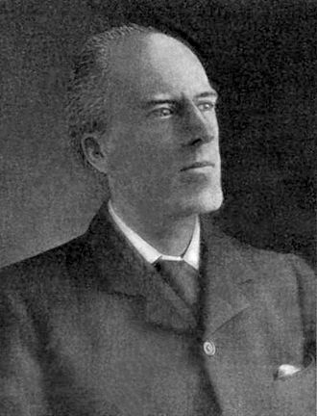
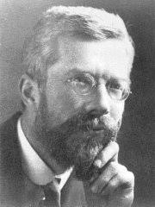

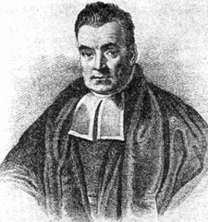
A brief history of statistics...
Middle of 18th century
19th century
20th century
Tax, economy, military data collection
Probability, uncertainty, mathematical foundation
Inference, prediction, modern concepts

Slide 5
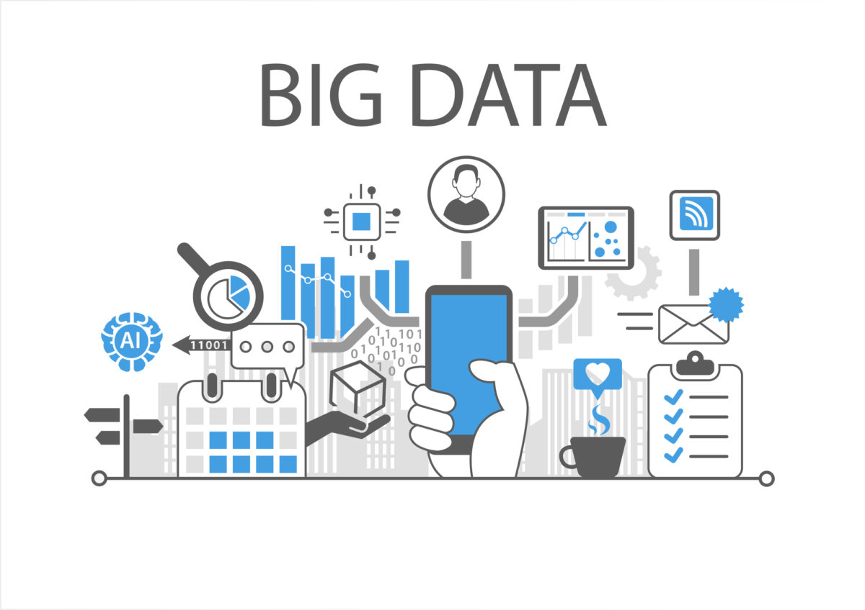
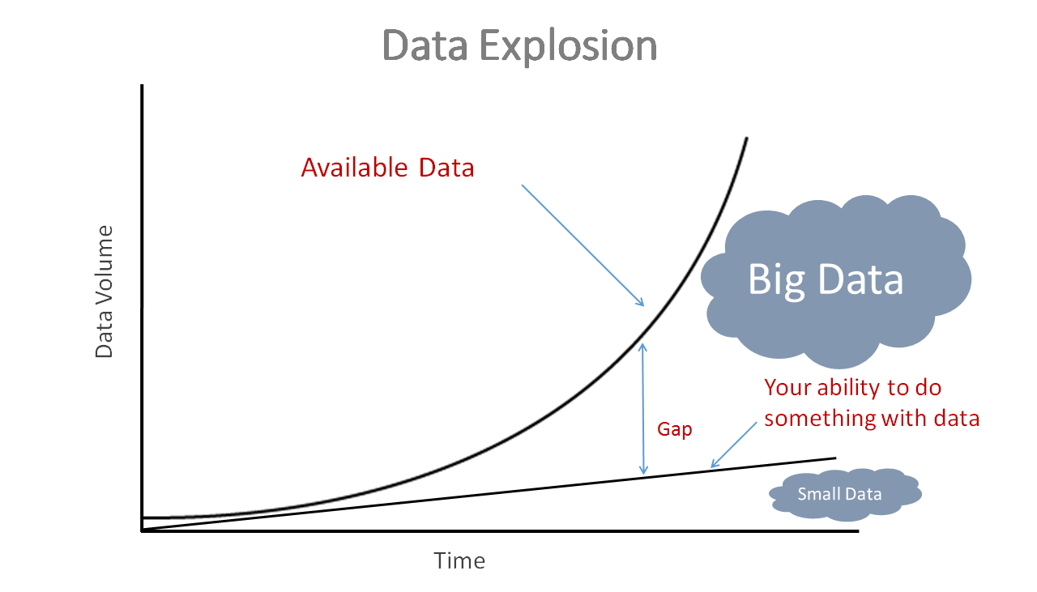
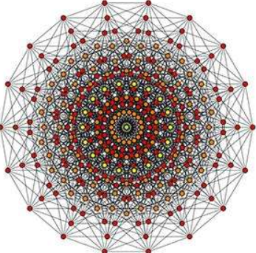

Why is statistics ‘hot’ today?
High-dimension
But statistics was developed to handle ‘Small Data’
Incredibly rich and mathematically sound modeling and prediction techniques
Standard way to deal with uncertainty
Fast, ‘good enough’ alternative to model data w/o using heavy computation
Bayesian approach fits naturally with the mantra of ‘update your belief’

Slide 6






Examples of statistics in action...
Linear and non-linear regression
Probabilistic modeling for motion control
Hypothesis testing, ANOVA
Descriptive stats, visualization
Failure analysis, QA models
Time series modeling, geo-spatial regression

Slide 7

What will we learn in this bootcamp?
Descriptive statistics, and probability basics
Central tendency and dispersions, bivariate analysis
Probability concepts, counting stuff
Statistical distributions - discrete and continuous
Exploratory data analysis (EDA)
Inferential and Bayesian statistics
Estimation
P-values, confidence intervals
Hypothesis testing, ANOVA
Bayes’ rule and its applications
Machine learning and data science applications
Linear regression
Logistic regression
Naive Bayes classification
Clustering and MLE
NumPy
Pandas
Matplotlib
Scipy
Statsmodels
Seaborn
MLR
Scikit-learn

